Slide 1
Analyzing SQL Server performance through the Query Store
Enrico van de Laar
http://www.querystoretools.com

Slide 2


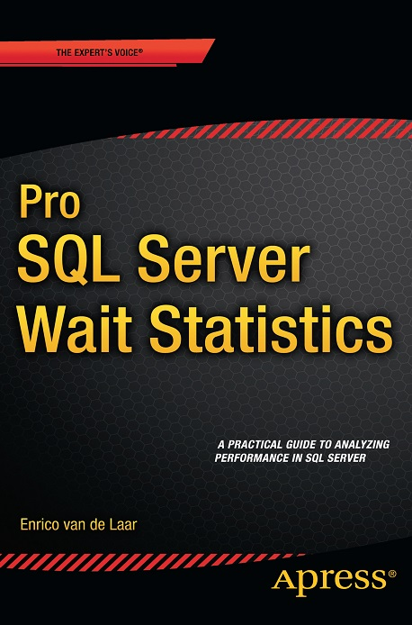




About me
QueryStoreTools.com
Chief Consultant DotNine
Product Manager PinkRoccade Hosting Services
MVP Data Platform
Blogger
Author
@evdlaar
http://www.dotnine.net
enrico@dotnine.net

Slide 3
Agenda for tonight
QueryStoreTools.com
Query Store feature recap
Runtime intervals and query statistics
Built-in Query Store access - Reports - DMVs
Custom Query Store solutions - Performance Dashboards - sp_WhatsupQueryStore - Query Store Replay

Slide 4
Query Store feature recap
QueryStoreTools.com
Query Store is the “flight recorder” of query performance
Enabled on a per-database level
Execution Plans and query runtime statistics are captured and persisted on-disk per-database
Available in all editions of SQL Server 2016

Slide 5
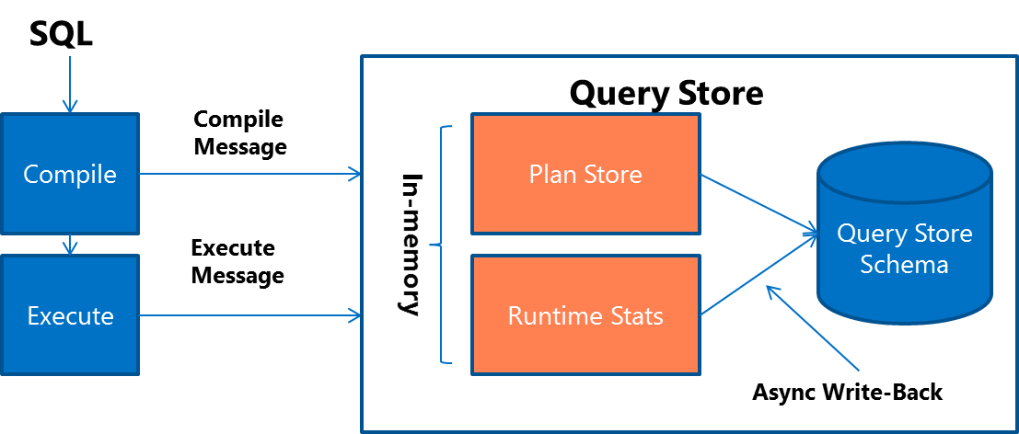
Query Store feature recap
QueryStoreTools.com
Source: https://msdn.microsoft.com/en-us/library/mt631173.aspx

Slide 6
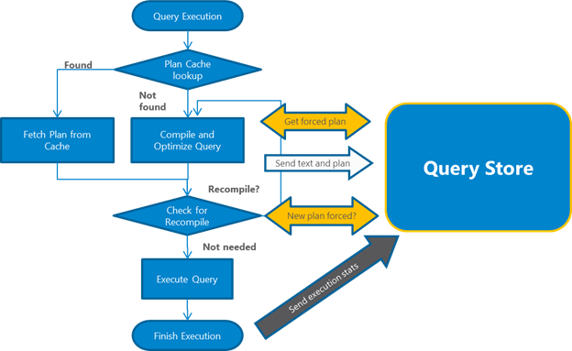
Query Store feature recap
QueryStoreTools.com
Source: https://msdn.microsoft.com/en-us/library/mt631173.aspx

Slide 7
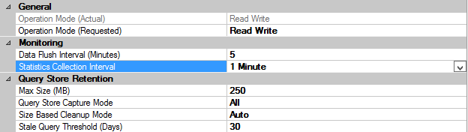
Runtime intervals and query statistics
QueryStoreTools.com
Query Store records and aggregates query runtime statistics by time intervals
The time interval depends on the “Statistics Collection Interval” setting
Notes:
Before we can get started analyzing query store data you must understand the intervals in which the query store records metrics

Slide 8
Runtime intervals and query statistics
QueryStoreTools.com
Query
Query
Query
100ms
100ms
200ms
0
Interval A
1
1
Interval B
2
exec_count : 1 avg_duration : 100ms
exec_count: 2 avg_duration : 150ms
Notes:
Demo: Query store runtime intervals

Slide 9
Built-in Query Store access
QueryStoreTools.com
Two methods available to access data in the Query Store - Built-in reports - DMVs
Built-in reports are a quick and easy method to access the Query Store
DMVs are great for programmatically accessing the Query Store data
Notes:
Built-in reports are limited since you cannot customize them and they do not show everything DMVs can be complex to use
Demo: Built-in reports & DMVs

Slide 10
Custom Query Store solutions
QueryStoreTools.com
Query Store Dashboards
Sp_WhatsupQueryStore
Query Store Replay
All of these solutions are available, 100% free, at http://www.querystoretools.com
Notes:
Custom demo’s

Slide 11
Additional information
QueryStoreTools.com
Simple talk Query Store article series https://www.simple-talk.com/author/enrico-van-de-laar/
Query Store Custom solutions http://www.querystoretools.com

